Slide 1
איתור מטרות במרחב רועש ע"י רובוט נייד המצויד בסנסור
קבוצה 2
כהן אליה
אשר יובל
מצליח ברוך
Notes:
The research deal with the problem of probabilistic search and detection of multiple targets by a group of mobile robots.
The robots are the agents, and the agents are equipped by a variety of sensors and they can communicate with each other.

Slide 2
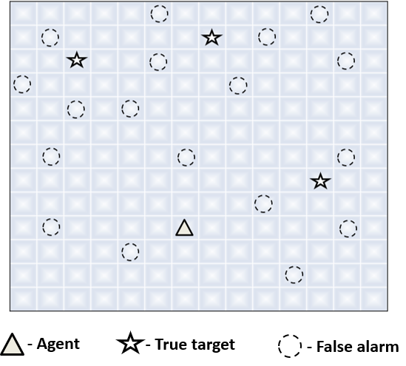
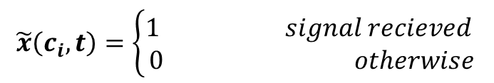



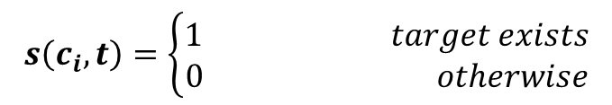

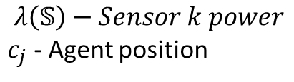
חיפוש מטרות ע"י סוכן מצויד בסנסור
$$s\left(c_{i},t\right)=\left\{\begin{aligned}1 target exists \\ 0 otherwise\end{aligned}\right.$$
$P\left\{s\left(c_{i},t\right)=1\right\}+P\left\{s\left(c_{i},t\right)=0\right\}=1$,
$$λ\left(𝕊\right)−Sensor k power$$
$c_{j}$ - Agent position
$$r_{ij}−The distance between (c_{i},c_{j})$$
$\tilde{a}\left(c_{i},t\right)=1$ - $alarm sent from c_{i}$
$$P\left\{\tilde{a}\left(c_{i},t\right)=1│s\left(c_{i},t\right)=1\right\}=P_{TA}$$
$P\left\{\tilde{a}\left(c_{i},t\right)=1│s\left(c_{i},t\right)=0\right\}=P_{FA}=α∙$ $P_{TA}$ $0≤α≤1$
$$P\left\{signal rercieved by the sensor | alarm sent from c_{i}\right\}=e^{−\frac{r_{ij}}{λ\left(𝕤\right)}}$$
$$\tilde{x}\left(c_{i},t\right)=\left\{\begin{aligned}1 signal recieved \\ 0 otherwise\end{aligned}\right.$$

Slide 3
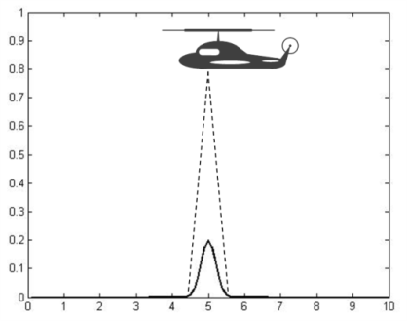

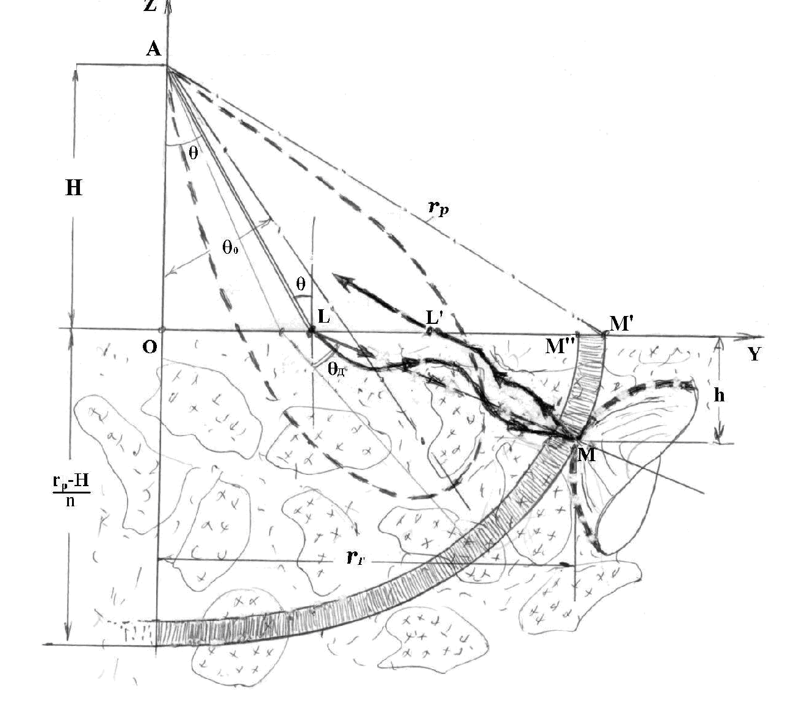
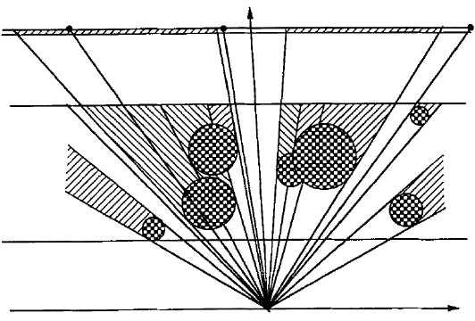
Sensing errors
False negative
False positive
Visibility and shadowing
Observer

Slide 4
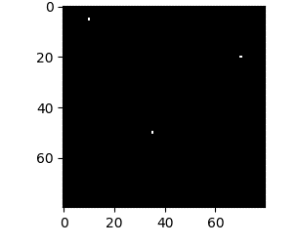
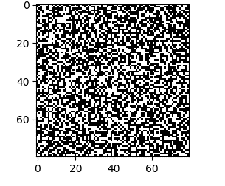
False Alarms vs. True Events - Example
Area size = 80x80 = 6400
Number of targets = 3
True events rate = 3 events per sec(per sensor)
FA rate = 3200 events per sec(per sensor)
Notes:
The noisy environment creates a large number of false alarm events.
Here we can see an example of comparison between FA rate created by the dummy targets, and the true events rate created by the true targets.
Area size = 80x80 = 6400
Number of targets = 3
True events rate = 3 events per sec(per sensor)
FA rate = 3200 events per sec(per sensor)
Its mean that the FA rate are larger in three orders of magnitude.
it’s a big challenge for the system.

Slide 5






Decision-making by expected information gain
Control - $V_{π}\left(t\right)$
Agent
Policy - $π$
$E\left[V_{π}\left(t\right) \right]−$Expected information gain at time t:
Observation
Action - $𝕒(t)$
$V_{π}\left(t\right)=D_{KL}\left(P^{global}\left(t\right)│𝕒(t)||P^{global}\left(t−1\right)\right)$,
True
alarms
False
alarms
$π\left(t\right)=\underset{𝕒(t)}{argmax}{E[V_{π}\left(t\right)]}$
Environment

Slide 6
מטרות והשגי הפרויקט
קלט :
נתוני הסנסור
קצב התראות השווא
קצב התראות אמת
מפת הסתברויות ראשונית
פלט: מציאת המטרות במרחב בזמן קצר
שליטה של הסוכן: מציאת מסלול התקדמות שיביא למציאת המטרות בזמן הקצר ביותר.

Slide 7



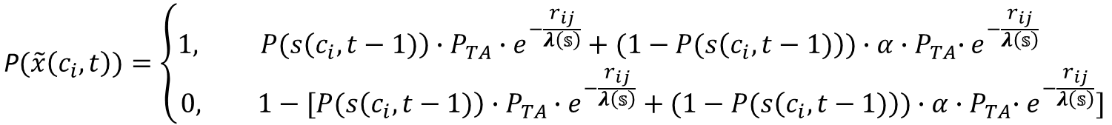
















$$\text{P}(\tilde{x}\left(c_{i},t\right))=\left\{\begin{aligned}1, P(s\left(c_{i},t−1)\right)∙P_{TA}∙e^{−\frac{r_{ij}}{λ\left(𝕤\right)}}+(1−P(s\left(c_{i},t−1)\right))∙α{{∙P}_{TA}∙e}^{−\frac{r_{ij}}{λ\left(𝕤\right)}} \\ &0, 1−[P(s\left(c_{i},t−1)\right)∙P_{TA}∙e^{−\frac{r_{ij}}{λ\left(𝕤\right)}}+(1−P(s\left(c_{i},t−1)\right))∙α{{∙P}_{TA}∙e}^{−\frac{r_{ij}}{λ\left(𝕤\right)}}]\end{aligned}\right.$$
$$1−P(s\left(c_{i},t−1)\right)$$
$$P(s\left(c_{i},t−1)\right)$$
$${1−α∙P}_{TA}$$
$${α∙P}_{TA}$$
$${1−P}_{TA}$$
$$P_{TA}$$
$$e^{−\frac{r_{ij}}{λ\left(𝕤\right)}}$$
$$e^{−\frac{r_{ij}}{λ\left(𝕤\right)}}$$
$$e^{−\frac{r_{ij}}{λ\left(𝕤\right)}}$$
$$e^{−\frac{r_{ij}}{λ\left(𝕤\right)}}$$
$${1−e}^{−\frac{r_{ij}}{λ\left(𝕤\right)}}$$
$${1−e}^{−\frac{r_{ij}}{λ\left(𝕤\right)}}$$
$${1−e}^{−\frac{r_{ij}}{λ\left(𝕤\right)}}$$
$${1−e}^{−\frac{r_{ij}}{λ\left(𝕤\right)}}$$
$$\tilde{x}\left(c_{i},t\right)=$$
$$0$$
$$0$$
$$0$$
$$1$$
$$0$$
$$0$$
$$0$$
$$1$$

Slide 8
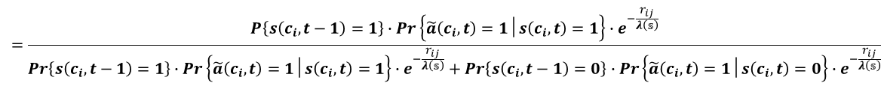
Sensor Probability Updating with false positive and false negative
$P\left\{s\left(c_{i},t\right)=1 | \tilde{x}\left(c_{i},t\right)=1\right\}=$ $\frac{P\left\{s\left(c_{i},t−1\right)=1\right\}∙P\left\{\tilde{x}\left(c_{i},t\right)=1│s\left(c_{i},t\right)=1\right\}}{P\left\{s\left(c_{i},t−1\right)=1\right\}∙P\left\{\tilde{x}\left(c_{i},t\right)=1│s\left(c_{i},t\right)=1\right\}+P\left\{s\left(c_{i},t−1\right)=0\right\}∙P\left\{\tilde{x}\left(c_{i},t\right)=1│s\left(c_{i},t\right)=0\right\}}$
$$=\frac{P\left\{s\left(c_{i},t−1\right)=1\right\}∙Pr\left\{\tilde{a}\left(c_{i},t\right)=1│s\left(c_{i},t\right)=1\right\}∙e^{−\frac{r_{ij}}{λ\left(𝕤\right)}}}{Pr\left\{s\left(c_{i},t−1\right)=1\right\}∙Pr\left\{\tilde{a}\left(c_{i},t\right)=1│s\left(c_{i},t\right)=1\right\}∙e^{−\frac{r_{ij}}{λ\left(𝕤\right)}}+Pr\left\{s\left(c_{i},t−1\right)=0\right\}∙Pr\left\{\tilde{a}\left(c_{i},t\right)=1│s\left(c_{i},t\right)=0\right\}∙e^{−\frac{r_{ij}}{λ\left(𝕤\right)}}}$$
$P\left\{s\left(c_{i},t\right)=1 | x\left(c_{i},t\right)=0\right\}=$ $\frac{P\left\{s\left(c_{i},t−1\right)=1\right\}∙Pr\left\{\tilde{x}\left(c_{i},t\right)=0│s\left(c_{i},t\right)=1\right\}}{P\left\{s\left(c_{i},t−1\right)=1\right\}∙P\left\{\tilde{x}\left(c_{i},t\right)=0│s\left(c_{i},t\right)=1\right\}+P\left\{s\left(c_{i},t−1\right)=0\right\}∙P\left\{\tilde{x}\left(c_{i},t\right)=0│s\left(c_{i},t\right)=0\right\}}$
= $\frac{Pr\left\{s\left(c_{i},t−1\right)=1\right\}∙\text{[}P\left\{\tilde{a}\left(c_{i},t\right)=0│s\left(c_{i},t\right)=1\right\}+Pr\left\{\tilde{a}\left(c_{i},t\right)=1│s\left(c_{i},t\right)=1\right\}⋅\{1−e^{−\frac{r_{ij}}{λ\left(𝕤\right)}}\}]}{Pr\left\{s\left(c_{i},t−1\right)=1\right\}∙\text{[}Pr\left\{\tilde{a}\left(c_{i},t\right)=0│s\left(c_{i},t\right)=1\right\}+Pr\left\{\tilde{a}\left(c_{i},t\right)=1│s\left(c_{i},t\right)=1\right\}⋅\{1−e^{−\frac{r_{ij}}{λ\left(𝕤\right)}}\}]+Pr\left\{s\left(c_{i},t−1\right)=0\right\}⋅\text{[}Pr\left\{\tilde{a}\left(c_{i},t\right)=0│s\left(c_{i},t\right)=0\right\}\text{+}Pr\left\{\tilde{a}\left(c_{i},t\right)=1│s\left(c_{i},t\right)=0\right\}⋅\{1−e^{−\frac{r_{ij}}{λ\left(𝕤\right)}}\}]}$
8

Slide 9











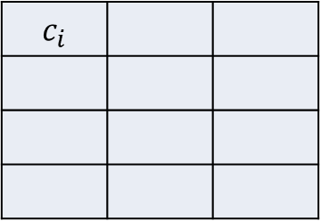



 |  | $$c_{i}$$
$P\left\{s\left(c_{i},t\right) |\tilde{x}\left(c_{i},t\right)=1\right\}=$ $\frac{P\left\{s\left(c_{i},t−1\right)\right\}∙P_{TA}}{P\left\{s\left(c_{i},t−1\right)\right\}∙P_{TA}+[1−P\left\{s\left(c_{i},t−1\right)\right\}]∙α∙P_{TA}}$
$$c_{j}$$
$$P\left\{s\left(c_{i},t\right) |\tilde{x}\left(c_{i},t\right)=0\right\}=\frac{P\left\{s\left(c_{i},t−1\right)\right\}∙\text{[}\left(1−P_{TA}\right)+P_{TA}⋅(1−e^{−\frac{r_{ij}}{λ\left(k\right)}})]}{P\left\{s\left(c_{i},t−1\right)\right\}∙\text{[}\left(1−P_{TA}\right)+P_{TA}⋅(1−e^{−\frac{r_{ij}}{λ\left(k\right)}})]+[1−P\left\{s\left(c_{i},t−1\right)\right\}]⋅\text{[}(1−α∙P_{TA}\text{)}\text{+}α∙P_{TA}⋅(1−e^{−\frac{r_{ij}}{λ\left(k\right)}})]}$$
$$P\left\{s\left(c_{i},t−1\right)\right\}$$
$$\tilde{x}\left(c_{i},t\right)=0$$
$$\tilde{x}\left(c_{i},t\right)=1$$
$$P\left\{s\left(c_{i},t\right) \right\}$$
$$P\left\{s\left(c_{i},t\right) \right\}$$
$$\tilde{x}\left(c_{i},t+1\right)=0$$
$$\tilde{x}\left(c_{i},t+1\right)=1$$
$$\tilde{x}\left(c_{i},t+1\right)=0$$
$$\tilde{x}\left(c_{i},t+1\right)=1$$
$$P\left\{s\left(c_{i},t+1\right) \right\}$$
$$P\left\{s\left(c_{i},t+1\right) \right\}$$
$$P\left\{s\left(c_{i},t+1\right) \right\}$$
$$P\left\{s\left(c_{i},t+1\right) \right\}$$

Slide 10

Information Gain
$$IG=D_{KL}\left(P^{global}\left(t\right)│\tilde{X}\left(t\right)||P^{global}\left(t−1\right)\right)$$
$\tilde{X}\left(t\right)$={$\tilde{x}\left(c_{1},t\right)$, $\tilde{x}\left(c_{2},t\right)$,…, $\tilde{x}\left(c_{N},t\right)$}

Slide 11




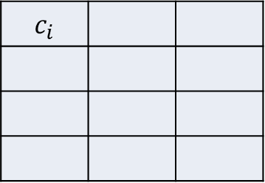
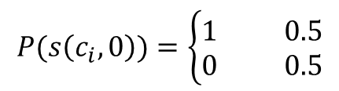
Single agent - Single cell - Example
$P_{TA}=1$ , $α=0$ , $\frac{r_{ij}}{λ\left(k\right)}=1$
 |  | $$c_{i}$$
If there isn’t prior information:
$$P(s\left(c_{i},0\right))=\left\{\begin{aligned}1 0.5 \\ 0 0.5\end{aligned}\right.$$
- Uniform distribution
$$c_{j}$$
$$H\left(c_{i},0\right)=\log{2=1[bits]}$$
$$Pr\left\{signal rercieved| alarm sent from c_{i}\right\}=e^{−1}=0.36$$
$$\text{P}(\tilde{x}\left(c_{i},1)\right)=\left\{\begin{aligned}1 P(s\left(c_{i},0)\right)∙P_{TA}∙e^{−\frac{r_{ij}}{λ\left(𝕤\right)}}=0.18 \\ 0 1−P(s\left(c_{i},0)\right)∙P_{TA}∙e^{−\frac{r_{ij}}{λ\left(𝕤\right)}}=0.82 \end{aligned}\right.$$
$P\left\{s\left(c_{i},1\right) |\tilde{x}\left(c_{i},1\right)=1\right\}=$ $\frac{P\left\{s\left(c_{i},0\right)\right\}∙P_{TA}}{P\left\{s\left(c_{i},0\right)\right\}∙P_{TA}}=1$
$$P\left\{s\left(c_{i},1\right) |\tilde{x}\left(c_{i},t\right)=0\right\}=\frac{P\left\{s\left(c_{i},0\right)\right\}∙\text{[}\left(1−P_{TA}\right)+P_{TA}⋅(1−e^{−1})]}{P\left\{s\left(c_{i},0\right)\right\}∙\text{[}\left(1−P_{TA}\right)+P_{TA}⋅(1−e^{−1})]+[1−P\left\{s\left(c_{i},0\right)\right\}]}=0.39$$
$$I\left(\tilde{x}\left(c_{i},1\right)\text{,} s\left(c_{i},0\right)\right)=0.21$$
$$H\left(s\left(c_{i},1\right)\right)=H\left(s\left(c_{i},0\right)\right)−I\left(\tilde{x}\left(c_{i},1\right)\text{,} s\left(c_{i},0\right)\right)=1−0.21=0.79[bits]$$

Slide 12
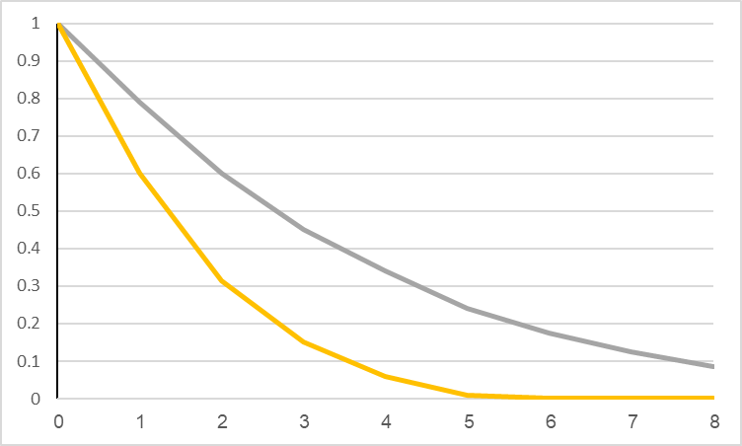


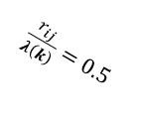
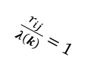

Single agent - Single cell - Example
$P_{TA}=1$ , $α=0$
Static agent
$$H\left(s\left(c_{i},t\right)\right)$$
[bits]
$\frac{r_{ij}}{λ\left(k\right)}=1$
$\frac{r_{ij}}{λ\left(k\right)}=0.5$
$$t$$

Slide 13
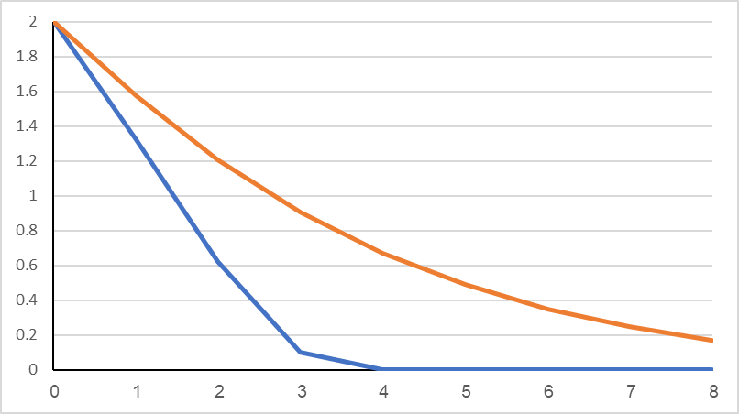



Single agent - Multi cells – Example 3
$P_{TA}=1$ , $α=0$
Static vs. moving agent
$$H\left(S(t) \right)$$
[bits]
Static agent
Moving agent
$$t$$

Slide 14
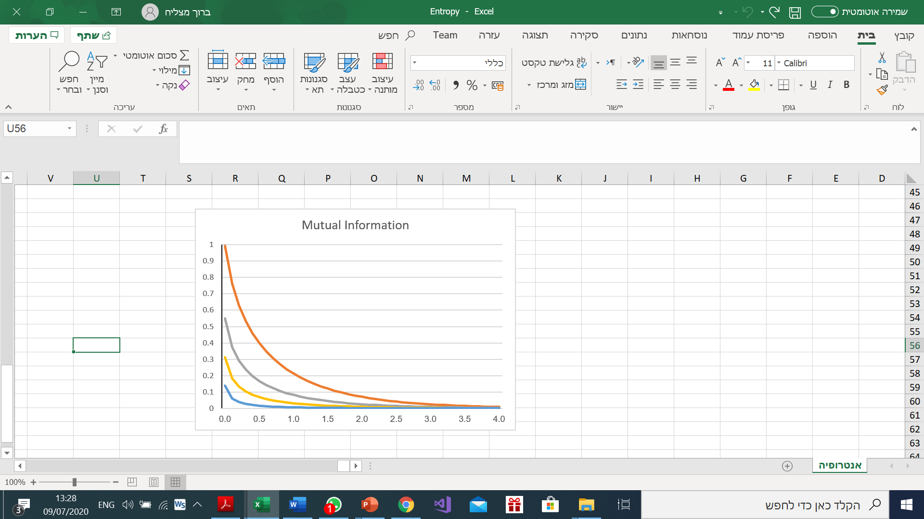
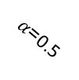

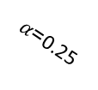
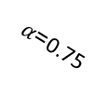

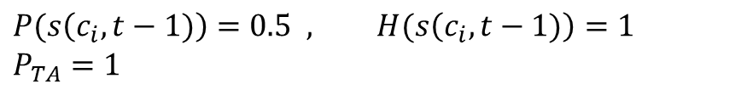

Converge rate
$$P(s\left(c_{i},t−1)\right)=0.5 , H(s\left(c_{i},t−1)\right)=1$$
$$P_{TA}=1$$
$I(\tilde{x}\left(c_{i},t\right)$, $s\left(c_{i},t−1\right))$
$α$=0
$α$=0.25
$α$=0.5
$α$=0.75
$$\frac{r_{ij}}{λ\left(k\right)}$$

Slide 15

Converge rate
 |  | $$c_{i}$$
$P(s_{jk}\left(c_{i},t\right)|\tilde{x}\left(c_{i},t\right)=1)=$ $\frac{P(s_{jk}\left(c_{i},t−1)\right)∙P_{TA}}{P(s_{jk}\left(c_{i},t−1)\right)∙P_{TA}+[1−P(s_{jk}\left(c_{i},t−1)\right)]∙α∙P_{TA}}$
$$c_{j}$$
$$P(s_{jk}\left(c_{i},t\right)|\tilde{x}\left(c_{i},t\right)=0)=\frac{P(s_{jk}\left(c_{i},t−1)\right)∙\text{[}\left(1−P_{TA}\right)+P_{TA}⋅(1−e^{−\frac{r_{ij}}{λ\left(k\right)}})]}{P(s_{jk}\left(c_{i},t−1)\right)∙\text{[}\left(1−P_{TA}\right)+P_{TA}⋅(1−e^{−\frac{r_{ij}}{λ\left(k\right)}})]+[1−P(s_{jk}\left(c_{i},t−1)\right)]⋅\text{[}(1−α∙P_{TA}\text{)}\text{+}α∙P_{TA}⋅(1−e^{−\frac{r_{ij}}{λ\left(k\right)}})]}$$
Expected value of $P\left\{s\left(c_{i},t\right)\right\}$:
$$E(P\left\{s_{jk}\left(c_{i},t\right)\right\}=P\left\{s_{jk}\left(c_{i},t\right)|\tilde{x}\left(c_{i},t\right)=1\right\}∙P\left(\tilde{x}\left(c_{i},t\right)=1\right)+P\left\{s_{jk}\left(c_{i},t\right)|\tilde{x}\left(c_{i},t\right)=0\right\}∙P\left(\tilde{x}\left(c_{i},t\right)=0\right)$$

Slide 16


Converge rate - Target exists in $c_{i}$
 |  | $$c_{i}$$
Case 1: Target exists in $c_{i}$
Expected value of $P(s_{jk}\left(c_{i},t\right))$
$$c_{j}$$
$$E[P(s_{jk}\left(c_{i},t\right)|Tar\left(c_{i},t\right)=1)] =P((s_{jk}\left(c_{i},t\right))|\tilde{x}\left(c_{i},t\right)=1)∙P\left(\tilde{x}\left(c_{i},t\right)=1|Tar\left(c_{i},t\right)=1\right)+P((s_{jk}\left(c_{i},t\right))|\tilde{x}\left(c_{i},t\right)=0)∙P\left(\tilde{x}\left(c_{i},t\right)=0|Tar\left(c_{i},t\right)=1\right)$$
$$E[P(s_{jk}\left(c_{i},t\right)|Tar\left(c_{i},t\right)=1)]=\frac{P(s_{jk}\left(c_{i},t−1)\right)∙P_{TA}}{P(s_{jk}\left(c_{i},t−1)\right)∙P_{TA}+\left[1−P(s_{jk}\left(c_{i},t−1)\right)\right]∙α∙P_{TA}}∙P_{TA}∙e^{−\frac{r_{ij}}{λ\left(k\right)}}+$$
$$\frac{P(s_{jk}\left(c_{i},t−1)\right)∙\text{[}\left(1−P_{TA}\right)+P_{TA}⋅(1−e^{−\frac{r_{ij}}{λ\left(k\right)}})]}{P(s_{jk}\left(c_{i},t−1)\right)∙\text{[}\left(1−P_{TA}\right)+P_{TA}⋅(1−e^{−\frac{r_{ij}}{λ\left(k\right)}})]+[P(s_{jk}\left(c_{i},t−1)\right)]⋅\text{[}(1−α∙P_{TA}\text{)}\text{+}α∙P_{TA}⋅(1−e^{−\frac{r_{ij}}{λ\left(k\right)}})]}{∙(1−P}_{TA}∙e^{−\frac{r_{ij}}{λ\left(k\right)}})$$
$$E[P(s_{jk}\left(c_{i},t\right)|Tar\left(c_{i},t\right)=1)]=\frac{P(s_{jk}\left(c_{i},t−1)\right)∙P_{TA}∙e^{−\frac{r_{ij}}{λ\left(k\right)}}}{P(s_{jk}\left(c_{i},t−1)\right)∙\left[1−α\right]+α}+\frac{P(s_{jk}\left(c_{i},t−1)\right)⋅{(1−e^{−\frac{r_{ij}}{λ\left(k\right)}})}^{2}}{P(s_{jk}\left(c_{i},t−1)\right)∙(1−{P_{TA}∙e}^{−\frac{r_{ij}}{λ\left(k\right)}})+[1−P(s_{jk}\left(c_{i},t−1)\right)]⋅ (1−α∙P_{TA}∙e^{−\frac{r_{ij}}{λ\left(k\right)}}\text{)} }$$

Slide 17
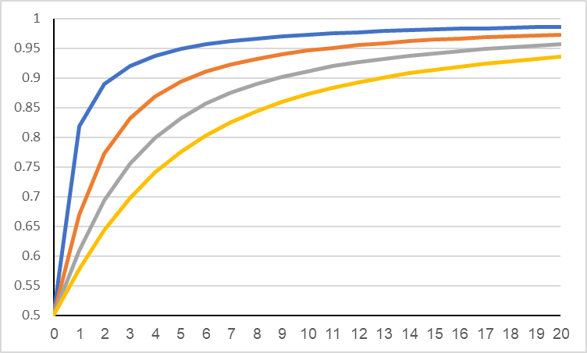
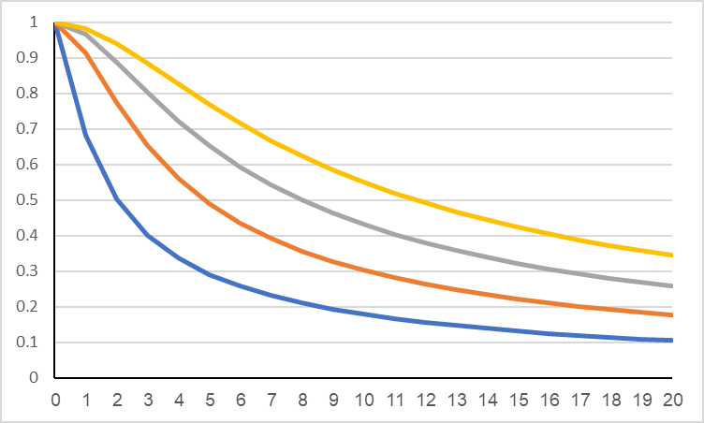














Converge rate - Target exists in $c_{i}$
Expected Probability
$P_{TA}=1$ , $\frac{r_{ij}}{λ\left(k\right)}=0.25$ ,$P(s_{jk}\left(c_{i},0\right))=0.5$
$$α=0$$
$$α=0.25$$
$$α=0.4$$
$$α=0.5$$
$$E[P(s_{jk}\left(c_{i},t\right))]$$
Expected Entropy
$$t$$
$$E[H\left(s\left(c_{i},t\right)\right)]$$
$$α=0.5$$
[bits]
$α=0$.4
$$α=0.25$$
$$α=0$$
$$t$$

Slide 18
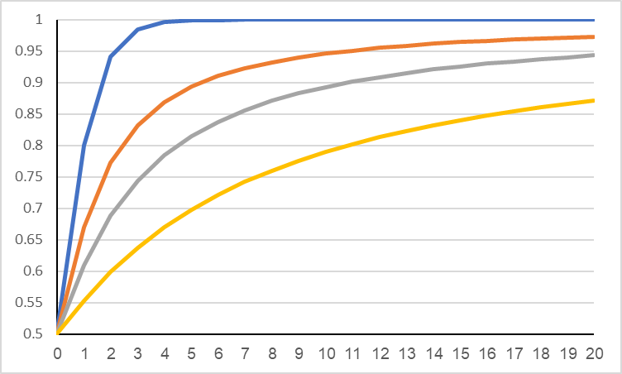
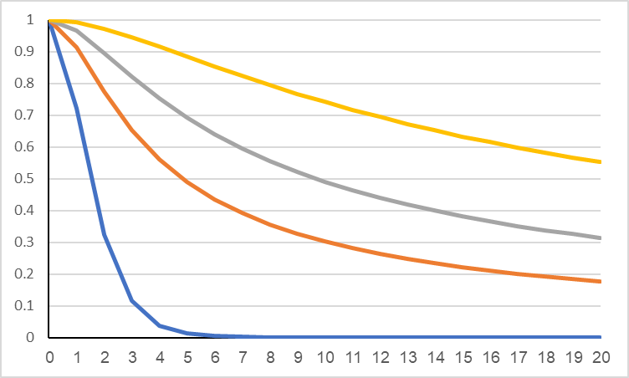














Converge rate - Target exists in $c_{i}$
Expected Probability
$P_{TA}=1$ , $α=0.25$ ,$P(s_{jk}\left(c_{i},0\right))=0.5$
$$\frac{r_{ij}}{λ\left(k\right)}=0$$
$$\frac{r_{ij}}{λ\left(k\right)}=0.25$$
$$\frac{r_{ij}}{λ\left(k\right)}=0.5$$
$$\frac{r_{ij}}{λ\left(k\right)}=1$$
$$E[P(s_{jk}\left(c_{i},t\right))]$$
Expected Entropy
$$t$$
$$\frac{r_{ij}}{λ\left(k\right)}=1$$
$$\frac{r_{ij}}{λ\left(k\right)}=0.5$$
$$E[H\left(s\left(c_{i},t\right)\right)]$$
$$\frac{r_{ij}}{λ\left(k\right)}=0.25$$
[bits]
$$\frac{r_{ij}}{λ\left(k\right)}=0$$
$$t$$

Slide 19


Converge rate - Target doesn’t exist in $c_{i}$
 |  | $$c_{i}$$
Case 2: Target doesn’t exist in $c_{i}$
Expected value of $P\left\{s\left(c_{i},t\right)\right\}$:
$$c_{j}$$
$$E\left[P\left(s_{jk}\left(c_{i},t\right) | Tar\left(c_{i},t\right)=0\right)\right]=P((s_{jk}\left(c_{i},t\right))|\tilde{x}\left(c_{i},t\right)=1)∙P\left(\tilde{x}\left(c_{i},t\right)=1|Tar\left(c_{i},t\right)=0\right)+P((s_{jk}\left(c_{i},t\right))|\tilde{x}\left(c_{i},t\right)=0)∙P\left(\tilde{x}\left(c_{i},t\right)=0|Tar\left(c_{i},t\right)=0\right)$$
$$E\left[P\left(s_{jk}\left(c_{i},t\right) | Tar\left(c_{i},t\right)=0\right)\right]=\frac{P(s_{jk}\left(c_{i},t−1)\right)∙P_{TA}}{P(s_{jk}\left(c_{i},t−1)\right)∙P_{TA}+\left[1−P(s_{jk}\left(c_{i},t−1)\right)\right]∙α∙P_{TA}}∙α∙P_{TA}∙e^{−\frac{r_{ij}}{λ\left(k\right)}}+$$
$$\frac{P(s_{jk}\left(c_{i},t−1)\right)∙\text{[}\left(1−P_{TA}\right)+P_{TA}⋅(1−e^{−\frac{r_{ij}}{λ\left(k\right)}})]}{P(s_{jk}\left(c_{i},t−1)\right)∙\text{[}\left(1−P_{TA}\right)+P_{TA}⋅(1−e^{−\frac{r_{ij}}{λ\left(k\right)}})]+[1−P(s_{jk}\left(c_{i},t−1)\right)]⋅\text{[}(1−α∙P_{TA}\text{)}\text{+}α∙P_{TA}⋅(1−e^{−\frac{r_{ij}}{λ\left(k\right)}})]}{∙(1−α∙P}_{TA}∙e^{−\frac{r_{ij}}{λ\left(k\right)}})$$
$$E\left[P\left(s_{jk}\left(c_{i},t\right) | Tar\left(c_{i},t\right)=0\right)\right]=\frac{P(s_{jk}\left(c_{i},t−1)\right)∙α∙P_{TA}∙e^{−\frac{r_{ij}}{λ\left(k\right)}}}{P(s_{jk}\left(c_{i},t−1)\right)∙\left[1−α\right]+α}+\frac{P(s_{jk}\left(c_{i},t−1)\right)⋅(1−e^{−\frac{r_{ij}}{λ\left(k\right)}}){∙(1−α∙P}_{TA}∙e^{−\frac{r_{ij}}{λ\left(k\right)}})}{P(s_{jk}\left(c_{i},t−1)\right)∙(1−{P_{TA}∙e}^{−\frac{r_{ij}}{λ\left(k\right)}})+[1−P(s_{jk}\left(c_{i},t−1)\right)]⋅ (1−α∙P_{TA}∙e^{−\frac{r_{ij}}{λ\left(k\right)}}\text{)} }$$

Slide 20
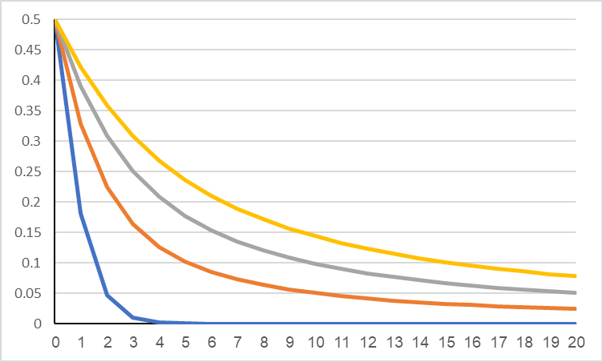











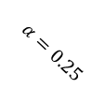
Converge rate - Target doesn’t exist in $c_{i}$
Expected Probability
$P_{TA}=1$ , $\frac{r_{ij}}{λ\left(k\right)}=0.25$ ,$P(s_{jk}\left(c_{i},0\right))=0.5$
$$E[P(s_{jk}\left(c_{i},t\right))]$$
$$α=0.25$$
$$α=0.4$$
$$α=0.5$$
$$α=0$$
Expected Entropy
$$t$$
$$E[H\left(s\left(c_{i},t\right)\right)]$$
[bits]
$$α=0.5$$
$α=0$.4
$$α=0.25$$
$$α=0$$
$$t$$

Slide 21
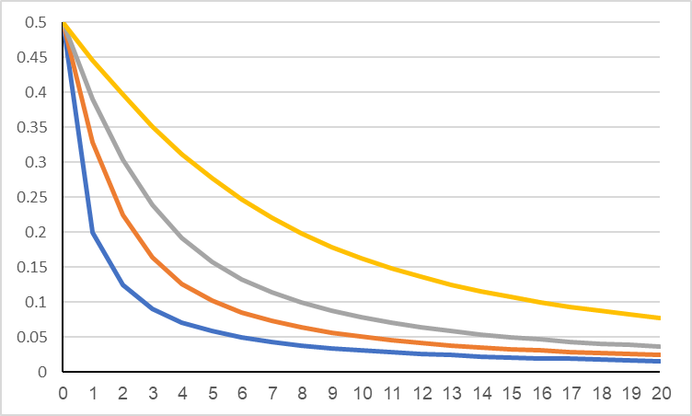
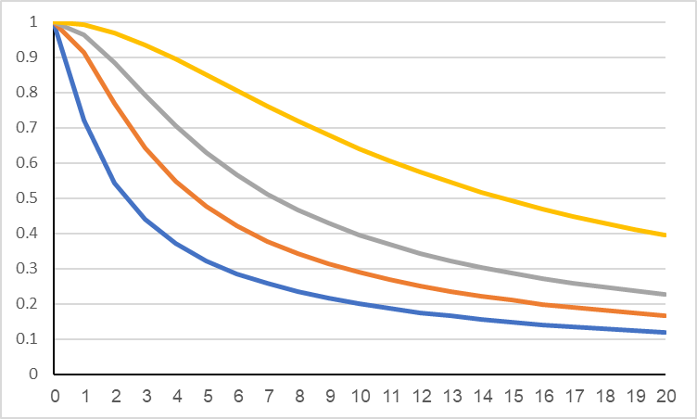








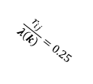

Converge rate - Target doesn’t exist in $c_{i}$
Expected Probability
$P_{TA}=1$ , $α=0.25$ , $P(s_{jk}\left(c_{i},0\right))=0.5$
$$E[P(s_{jk}\left(c_{i},t\right))]$$
$$\frac{r_{ij}}{λ\left(k\right)}=1$$
$$\frac{r_{ij}}{λ\left(k\right)}=0$$
$$\frac{r_{ij}}{λ\left(k\right)}=0.25$$
$$\frac{r_{ij}}{λ\left(k\right)}=0.5$$
Expected Entropy
$$t$$
$$\frac{r_{ij}}{λ\left(k\right)}=1$$
$$\frac{r_{ij}}{λ\left(k\right)}=0$$
$$\frac{r_{ij}}{λ\left(k\right)}=0.5$$
$$E[H\left(s\left(c_{i},t\right)\right)]$$
$$\frac{r_{ij}}{λ\left(k\right)}=0.25$$
[bits]
$$t$$

